Slide 1

Order Management

Slide 2
What is Order Management?
Order Management is a system that brokers (or exchanges) data between the front office customer request and the back office fulfillment systems to deliver accurate services to the customer.
Its job is to ensure that all fulfillment systems receive the data that they need, at the precise time they need it, in order to successfully deliver telecommunications services.

Slide 3
A best-in-class order management application is responsible for providing a number of key functions:
Validation of Orders: It should provide two types of validation: First, the application should ensure that the order is properly structured (we refer to this as syntactical validation). Second, it should ensure that the products and services on the order are allowed to be fulfilled (we refer to this as commercial validation). To create this validation, we’ll use the business rules we define in the shared product catalog.
Decomposition of Orders: It should convert commercial order information into technical order information. Here again, we’ll use the rules provided in the shared product catalog.
Communication with Fulfillment Systems: The application should communicate with fulfillment systems to send and receive information in the correct sequence.
Manage Fulfillment Lifecycle and Notifications: It should manage the entire order lifecycle, providing notifications for events and handling errors that occur.
Zero-touch vs. Manually Driven: A best-in-class order management application should find the right balance between manual and automated tasks, to maximize accuracy and efficiency.

Slide 4
Vlocity Order Management - Our Goals
The goal of Vlocity Order Management is to revolutionize the order management space by providing the first enterprise catalog-driven order management application that:
Integrates into your end-to-end ecosystem by combining a complete product, service and resource model to drive sales, CPQ, ordering and fulfillment functions
Provides one user interface with common tools, enabling your teams to collaboratively and rapidly create, manage and deliver offerings to market.
Allows for an evolutionary approach to transform both front office and back office systems to become catalog-driven over time. This supports the elimination of data silos and the mastering of both Commercial and Technical entities in a single model.

Slide 5
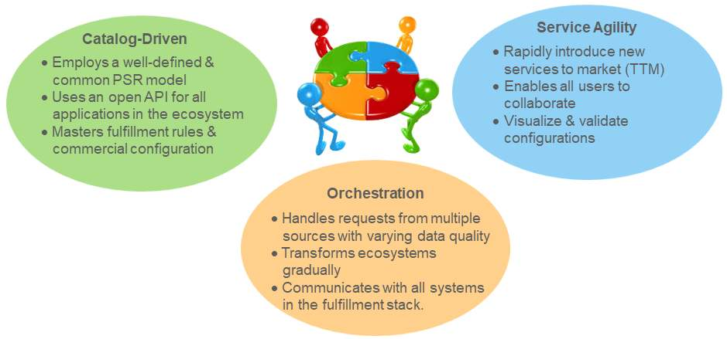
Critical Service Provider Operational Needs

Slide 6
Vlocity Order Management Solution Map
At a high level, Vlocity Order Management provides the following layers of functionality:
Orders are received from various systems, like retail, web or mobile applications. We call this omni-channel order submission.
Order Decomposition uses the relationships and rules defined in the catalog to enrich the commercial order with the technical information required to fulfill it.
Order Fulfillment is then responsible for tracking orders through a lifecycle of states, dynamically generating workflows and controlling and sequencing the interactions with fulfillment systems.
The Fulfillment System Interaction Layer provides integration logic for communicating with fulfillment systems, using technologies like DataRaptor, Apache Camel and Java.

Slide 7
Order Decomposition
The process of decomposition includes a number of important functions:
As each order is received, Order Decomposition uses the catalog to enrich the commercial order with the technical attributes needed for fulfillment.
Next, Order Decomposition checks subscriber inventory to ensure the appropriate fulfillment actions are taken based on the services the customer already has.
And finally, Order Decomposition generates a series of sub-orders, or fulfillment requests, that include related fulfillment tasks.

Slide 8
Order Orchestration
The Vlocity Orchestration process:
Uses the catalog to dynamically generate fulfillment actions based on the order context
Enforces any dependencies in the fulfillment actions
Establishes and maintains connections to fulfillment systems and applies the correct logic to handle connections
Interacts with external fulfillment systems such as Inventory, Activation, Billing and Workforce Management to exchange the data needed for fulfillment

Slide 9
Fallout Handling and Manual Tasks
Vlocity's Order Management’s Fallout Handling and Manual Task Capabilities:
Automatically detect errors from external fulfillment systems using error codes
Highlight failed tasks in the process flow, enabling fallout managers to quickly locate and troubleshoot issues
Automatically assign tasks to queues for manual resolution, allowing users to retry, complete or skip tasks

Slide 10
Connection Handling and Integration
Vlocity Order Management's Connection Handling and Integration Logic capabilities:
Automatically detect connection failures
Queue up fulfillment requests for retry rather than generating fallout
Attempt to re-establish failed connections according to pre-defined retry policies
Restart fulfillment requests when connections are successfully re-established
Provide comprehensive protocol and integration technology such as DataRaptors

Slide 11
User Experience
Vlocity used to have a close partnership with Salesforce. Now it's even better than that: We are Salesforce! Our Order Management provides a seamless user experience with:
Single-sign on for all users of the system including those performing fulfillment related roles such as fallout managers and fulfillment designers
Transparent navigation and consistent application look and feel for both design-time and run-time functions
Centralization of all product, service and resource configurations in the catalog that allow users to easily collaborate

Slide 12
Order Management and the Shared Catalog
The Vlocity Shared Catalog is the foundation for our Configure Price Quote (CPQ) and Order Management (OM). The shared catalog describes all of the incarnations of a product, as it travels from a twinkle in the customer's eyes to the physical implementation in the customer's hands. The shared catalog supports all levels of product definitions, including offers, product specifications, services and resource specifications. Using Order Management, product specifications are translated into various technical and fulfilment products that are tuned to each of the downstream systems that use them.

Slide 13
Terminology
Commercial products
Products in the Shared Catalog that are commercial (what the customer sees).
Technical products
Products in the Shared Catalog that are technical (what the customer does not see, but are critical for downstream order fulfillment systems).
Shared Catalog
The shared catalog includes both commercial and technical products. The Product Console provides create, read, update, and delete (CRUD) functionality for the shared catalog.
Order Management
The first catalog-driven order management system for the enterprise.
From a technical perspective, Order Management has two key facets:
Order Decomposition
Order Orchestration

Slide 14
Terminology
Commercial Products
Commercial products are most easily understood as the products in the shared catalog that the customer sees. Commercial products are the things you order from a catalog and toss into your shopping cart.
Technical products
For now, consider the following additional helpful points:
Technical products are also in the Shared Catalog. (They don't have their own catalog.)
Similar to the way customers understand commercial products, downstream fulfilment systems understand technical products.
The process of mapping commercial products to technical products in order to communicate with downstream order fulfilment systems is called order decomposition.
Map from/Map to
Commercial product fields and attributes map to technical product attributes. Technical products contain attributes only, not fields. Don't worry if this is a bit nebulous right now, it will make more sense soon.

Slide 15
Getting Started with Order Decomposition

Slide 16
Types of Decomposition Relationships
One to One (1:1)
Probably the most common and straight forward type of decomposition relationship. In this example, the Home Hub Modem (commercial product) decomposes to the Home Hub Modem (technical product).
One to Many (1:M)
Sometimes a single commercial product should decompose to one of several different technical products. This simply means a single source product will have multiple decomposition relationships. In this example, based on what the Grade attribute is set to (Good or Best), the relationship is set to Model 2000 or Model 3000.
Many to One (M:1)
Many to one relationships use multiple decomposition relationships in combination with the Scope function. In M:1 relationships decomposed fulfilment requests can be consolidated, which is more efficient when communicating with fulfilment systems.

Slide 17
Types of Decomposition Relationships
Lastly, you can also create multi-level decomposition relationships. They are comprised of 1:1, 1:M, and/or M:1 relationships. As a best practice, Vlocity recommends having a maximum of four levels. Remember, sometimes simpler is better.
Again, decomposition relationships map fields and attributes of commercial products to the attributes of technical products. Notice that the source product data can be a field or an attribute, but the destination product data must be stored as an attribute. That is, a technical product contains only attributes (not fields).
There are two more things you should know about before building out decomposition relationships:
Conditions
Mapping Rules

Slide 18
Conditions and Mapping Rules
A condition rule places a condition on the decomposition relationship. Order Management initiates decomposition of an order item only if the specified condition evaluates to true. Otherwise, Order Management skips the decomposition relationship.
Similar to an SQL WHERE Clause
Condition rules function very similar to an SQL Where clause. However, rather than restricting the data set returned from a query, they are used as control logic for the decomposition process. Only decompose if <whatever> is true.

Slide 19
Conditions and Mapping Rules
Mapping rules define the information passed from the source product to the destination product, and thereby to downstream systems. Although you may want to pass the attribute or field data "as is", you don't have to.
There are three different types of Mapping Rules.
Ad-verbatim - Copies the value from source to destination, without changing it. This simply passes data through untouched.
List - Transforms the source value to a new destination value. For example, map a "Gold" or "Silver" plan to a specific throughput speed such as "100Mbps" or "80Mbps".
Static - Set a predefined value for the destination attribute.

Slide 20
Understanding 1:1 Decomposition Relationships
One to One (1:1)
One to one decomposition relationships are very common, and usually pretty straight forward to configure. They decompose a single commercial or technical product, to a single technical product.
Creating a 1:1 Decomposition Relationship
Order Management gives you the tools to translate commercial products to their corresponding technical products. It does this using decomposition relationships that map fields and attributes of commercial products to the attributes of technical products.

Slide 21
Understanding Multi-Level Relationships
Multi-Level Decomposition Relationships
Some scenarios suggest the product model needs multiple levels to fully translate the commercial products to technical products. Order Management supports multi-level decomposition to accommodate such uses cases.
Decomposition Matrix
Configuring multi-level decomposition relationships often includes mapping a source product to multiple destination products based on a set of attributes. Order Management provides a handy tool, called a decomposition matrix to help with such configurations.

Slide 22
Limitations Of Decomposition Matrix
There are two limitations to consider when using decomposition matrices.
Decomposition relationships are from the source product to the destination product only. (From the destination to source is not permitted.)
When multiple attributes map to a single destination product, by default they use a logical AND.

Slide 23
Understanding M:1 Decomposition Relationships
Multiple commercial products that are on the same order can decompose to a single fulfilment request for a technical product. Doing so results in efficiency gains and streamlines the decomposition execution process.
Scope
Setting the Scope field on the product entity allows the decomposition results to be reused, instead of re-instantiated. The two most common scope settings are:
Order Item (default)
Account
Order Management generates a number of Fulfillment Request Lines (FRLs) for downstream order items as a result of the decomposition process. Setting the scope to Order Item or Account changes the number of fulfilment requests in the decomposed order.

Slide 24
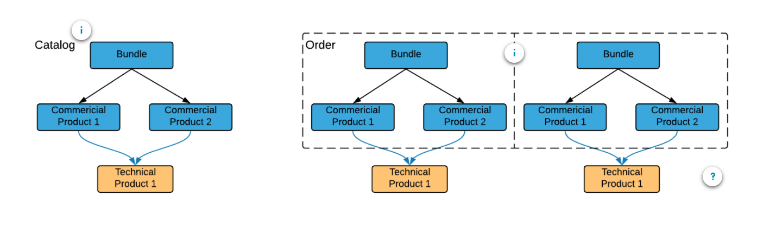
Order Item Scope
The diagrams below help illustrate the different behaviors based on the product scope setting.
Based on the product catalog (below left), and the scope set to Order Item, an order for a mobile product bundle results in two fulfilment requests when decomposed. Click on the hot spots below to see additional information.

Slide 25
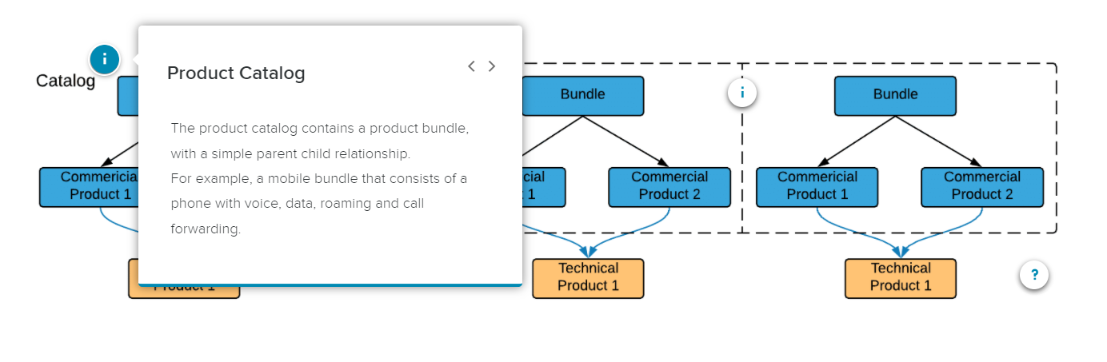
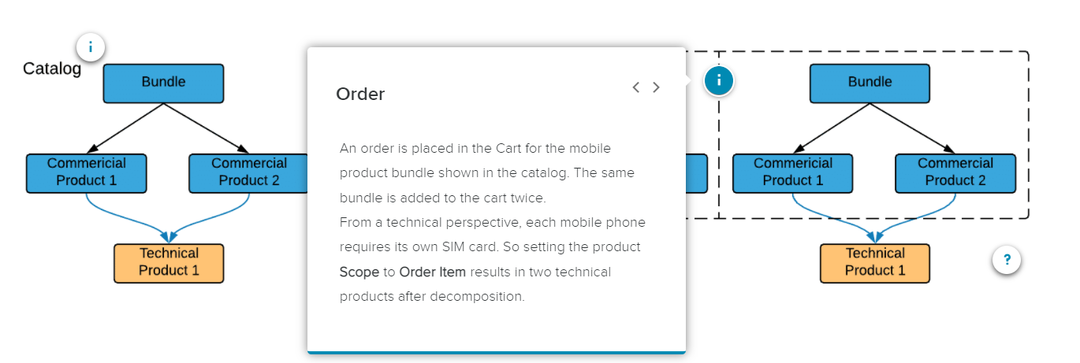
Order Item Scope

Slide 26
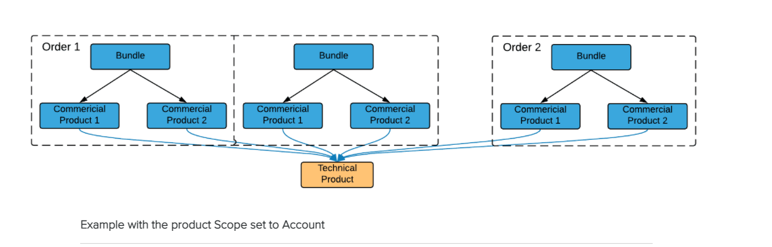
Account Scope
If the scope is set to Account on the product and decomposed, it results in a single fulfilment request. This of course streamlines the processing and communications with downstream systems

Slide 27
What is Product Class Decomposition?
Product Class
By default, when you create a new product using the Product Console, the Record Type is set to Product. Technically speaking, Product Class is an abbreviated way to refer to a product with the Record Type set to Class.
Product Class is not simply a commercial product or technical product, it's a mechanism used by Order Management to categorize certain products in order to simplify the order decomposition process.
Using Product Class
Implementing decomposition by Product Class includes three main steps:
Create the Product Class
Associate similar commercial products with the Product Class
Create a single decomposition relationshi

Slide 28
Understanding Order Orchestration

Slide 29
Terminology
Orchestration Plan Definition
A set of tasks grouped logically together in a plan, used to fulfill orders across one or more fulfillment systems. Note that the tasks processed are for the fulfilment requests that were created by the decomposition process. (That is, decomposition feeds into the orchestration process.)
Orchestration Item Definition
Tasks that make up an orchestration plan. They are executed in sequence (synchronous) or in parallel (asynchronous). There are 5 types: Milestone, Auto-Task, Callout, Manual Task, and Push Event.
Orchestration Scenario
Used to determine when an orchestration plan should execute. They are tied to a product and an action (such as Add, Modify, Disconnect, or NoChange). For example, execute ScheduleRouterInstall (plan) if HSRouter is added (action) to an order. Orchestration Scenarios optionally support sub-actions too.

Slide 30
Types of Orchestration Item Definitions
Milestone
A simple task used as a marker in the fulfilment process.
There is a saying "Love never fails"... well Milestones don't either! They always evaluate to True.
Manual Task
As implied by the name, a Manual Task is used when user input is needed at a particular place in the fulfilment flow. Common examples are supervisor approval, a credit check, or purchasing more coffee for the break room. Manual Tasks are placed in Manual Queues, where they can be taken off the queue, worked on, and eventually completed.
Auto Task
Auto-tasks are tasks that automatically execute by invoking an Apex class associated with the orchestration item. The most common example for an Auto-Task is creating assets for an order as one of the last steps in order fulfillment. Salesforce Industries provides an Apex class called XOMAutoTaskAssetizer out of the box to accomplish this.
It's considered best practice to create assets as the second to last task in the orchestration plan. (Basically, to assetize just prior to completing orchestration with a Milestone that can't fail.)
CallOut
A Callout is an automated interaction with an external fulfilment system using a web service or RESTful API. Again, common examples include billing systems, scheduling systems, inventory systems, etc. Although they are often third party systems, they could be internal systems as well
Push Event
A push event is activated when an external system or a Salesforce user makes a specific change to the order associated with a push event orchestration item. A push event pauses until an event (e.g. event condition) evaluates to true. Triggers are used to constantly evaluate the event condition.

Slide 31
High Level View
Color coded status- Each task is represented by a color coded card in the plan view. The colors of the card depict the current status.
Green - Completed
Blue - Ready
Light Gray - Pending
Dark Gray - Skipped
Red - Failed
Swimlanes - Horizontal grouping of items in the plan. Each Orchestration Plan Definition is depicted by a swim lane, and typically represents a single downstream system for order fulfillment. (Billing, Activation, etc.) Often, there is an end-to-end plan that organizes or invokes other orchestration plan definitions, which creates multiple swim lanes.
Types of Tasks - Notice below each task name in the card header is the type of task. The example plan includes Milestones, Manual Tasks, Auto Tasks, and Callouts. (A Push Event is not in the example plan, but is part of a hands-on exercise.)
Dependencies - Lines connecting cards show dependencies, such as tasks that depend on the completion of other tasks before they can begin. When you hover over a task in the Orchestration Plan view, the dependencies for that task are highlighted in re

Slide 32
Conditions
Orchestration provides two types of conditions to assist with the control of order fulfilment.
Orchestration Item Definition Conditions
Orchestration Item Definition conditions control whether the task should execute if the condition is met, or skipped if the condition is not met.
Orchestration Scenario Conditions
Thus far, you have seen orchestration scenarios used to determine when an orchestration plan should execute based solely on a product, and an action (or actions). However, you can also specify conditions. One or more conditions can be specified that examine the product attribute or field against values you specify. This provides finer grain control over the scenarios and thus the presence of the orchestration plan swimlanes on the generated orchestration plan.

Slide 33
Understanding Orchestration Plans
Orchestration Plans are automatically, dynamically generated when an order is decomposed. The mechanism that triggers the generation and execution of a new plan is the Orchestration Scenario. The Orchestration Scenario is tied to a product (usually a technical product such as a specific router, modem, or installation service), and an action (such as Add, Modify or Disconnect).

Slide 34
Clicking the Start Order (Milestone) task, drills down and reveals the Details tab for that specific Orchestration Plan Item. Notice the following:
Link to the orchestration plan (Plan0000039)
Task State (Completed, which is confirmed by the green color of the Start Order tile)
Four orchestration queues are created for you during the managed package installation. The Start Order task was assigned to Queue 1. (Other tasks in the same plan can get assigned randomly to different queues for processing.)
The Fulfillment Request (FR) from the decomposition is also displayed and can be drilled down on for more information.
Additional information can be accessed easily using the blue hyperlinks, improving the user experience.

Slide 35
Drilling down on the example Delivery Plan Manual Task shows a few new bits of information (highlighted in red in the screen shot above).
A different Orchestration Queue assignment (Queue 2)
A different State (Ready, as shown in the blue Delivery Plan tile)
Manual Tasks are assigned to administrator created Manual Queues. (Operations queue in this example. Manual Tasks and Manual Queues are covered in more detail in a later module.)
The Related tab shows dependencies. For Delivery Plan, there are none. However, drilling down on the Credit Card Check tile would show a dependency (on completion of Delivery Plan). Also notice that red segments indicate dependencies when viewing the tiles in the actual orchestration plan. (Dependencies are covered in a later module as well.)

Slide 36
Understanding Manual Tasks & Manual Queues
Manual Tasks
Manual Tasks require some level of human intervention. Although that can be as simple as supervisor approval, it can also include a custom execution URL that runs a custom OmniScript. For example, one that steps through credit approval or warehouse inventory checks. So, manual tasks don't necessarily mean you're using a low-tech approach. Instead, Manual Tasks can be cutting-edge with a high-tech OmniScript!!
Manual Queues
Manual Tasks get placed in Manual Queues. Unlike Orchestration Queues, which are created for you as part of the managed package installation, Manual Queues are created by Administrators or Fulfillment Designers. Creating Manual Queues is extremely easy to do. Although queues in OM Standard do not allow for prioritization, you can create several queues to help balance workloads. For example, you can create a queue for each swim lane. That way, a resource that is heavily-used (such as inventory) does not impose bandwidth limitations for one that is not (scheduling home installations). OM Standard also supports round robin and least loaded queue types. In addition to that, OM Plus supports priority queues.

Slide 37
There are a few other things to note before moving on.
Point of No Return (PONR)
If PONR is checked, once the task is completed, the status of the associated order (or order-item) is marked "PONR". PONR is key when using features such as canceling or amending in-flight orders. Once reached, OM communicates to CPQ that the order (or order-item) cannot be cancelled. (Note that other line items may be cancelled, depending on configuration. That is, part of an order may still be can be canceled.)
Custom Task Execution URL
URL to execute when the task is picked up from the queue. The URL points to a VisualForce page or OmniScript.
Rollback
fields are discussed later in the Order Cancellation section. In-flight amendments function very similar to cancellations (but are not covered in OM Essentials learning path.)
Manual Queues – Specification
Before clicking any buttons to perform various actions against items in the queue, you must specify which items. After-all, there could be dozens, hundreds, or even thousands of items in a queue! There are two ways to specify what items in the queue to work with:
Checkboxes - Select one or more items, then click an action button.
Bulk Operations - Operate on all or a batch of "n" entries in the queue.

Slide 38
Understanding Orchestration Auto Tasks
Unlike Manual Tasks that wait on user intervention, Auto Tasks automatically execute by invoking an Apex class associated with the orchestration item. They are used for internal processing of data.
Weird Words
Gubbins - Object with little to no value.
Snollygoster - Clever, unscrupulous person.
Salesforce Industries saw fit to create another weird word: Assetize (or assetizer). It may be an odd word used in the communications industry, but it's important, and very common when it comes to Auto Tasks.
Assets - A specific model or type of product that a customer owns.
Assetization - The process by which Order Management converts OrderItems into Assets and Fulfillment Request Lines (FRLs) into Inventory Items

Slide 39
XOMAutoTaskAssetizer
A common use of the Auto Task is to create assets as one of the last steps of order processing.
Order Management provides an out-of-the-box item implementation called Assetize and an Apex class called XOMAutoTaskAssetizer to perform this function. XOMAutoTaskAssetizer creates assets from the corresponding order at the end of processing. In fact, it's considered best practice to assetize as the second to last step in the orchestration plan. The last step is typically "Complete Order", a Milestone that cannot fail.
The Assetize item implementation only assetizes commercial products. Technical products are not assetized.

Slide 40
Understanding Orchestration Dependencies
Dependency Definitions
Sequencing matters in order orchestration as well. Dependency Definitions are the mechanism used to specify dependencies between Orchestration Items. You can set dependencies between items in the same plan, or between items in different plans. As you might expect, dependencies enforce a completion of one task before the next task is started. Hence, tasks can be run synchronously, not asynchronously. In short: Complete <Task_X> before starting <Task_Y>.
Creating a Dependency Definition
Navigate to the Orchestration Item Definition within the Orchestration Plan Definition, switch to the Related tab, click New and fill out the dependency information.
When setting up dependency information, don't forget to switch to the Related tab of the Orchestration Item Definition. (It's easy to overlook this at first.)

Slide 41
Note that there are two different types of dependencies:
Depends On (default) –
Makes the orchestration item depend on the successful completion of another orchestration item. In the example shown in the image above, the Complete Order item (Orchestration Item Definition) depends on the completion of the Create Assets item (Dependency Item Definition). Select the item further down the sequence, and set it to depend on the item before it.
Should Be Processed Before -
Functionally the same as Depends On, however, the vantage point is changed. The orchestration item must complete before beginning the next item in the sequence. Select the item further up the sequence, and set it to depend on the item after it.

Slide 42
Understanding Orchestration Systems & Callouts
Ultimately, order management is about proper order fulfillment. Salesforce Industries Communications Cloud alone does not accomplish this. It takes other third party or downstream systems to help complete order fulfillment. Hence, Communications Cloud needs to be able to communicate with downstream systems for functionality that extends past our Order Management functionality. For example, communicating with billing, inventory, scheduling, and logistics systems. These are referred to as orchestration systems.
Orchestration systems are used to define external systems that participate in the orchestration process for order fulfillment.

Slide 43
Creating an Orchestration System
Because both "core" Salesforce Industries and Order Management require setup for external orchestration systems, there is bit more configuration required to setup Callouts as part of an orchestration plan (as opposed to other items discussed thus far). Lets see the high level steps first, then drill down deeper from a Configuration and then Orchestration perspective.
Create the orchestration system in Order Management
Create the System Interface for the orchestration system
Setup the Remote Site Settings in Salesforce
Create the Callout Orchestration Item Definition
Test the new orchestration system

Slide 44
Configuration
Both Order Management and Salesforce need to be configured to communicate with an external system.
Create the orchestration system in Order Management
Creating a new orchestration system only requires two pieces of information.
System Name: Name of the system (Training_Mocker)
URL: URL for request/response communication with the orchestration system. (https://callouts-mock.training.vlocity.xom.vloc-dev.com)
Well, maybe three pieces if you include how to invoke the New System dialog. ;-) Navigate to the Systems tab of Order Management, then click New.

Slide 45
Create thy System Interface
Including "thy" in the sub-heading above was an honest typo, but it just felt right to leave it be. It has an air of importance about it.
Although the orchestration system has been created, there is still more information needed to configure two-way communications with it. Switch to the Related tab of the orchestration system to create a new System Interface. In addition to a System Interface Name, you must provide:
Implementation
The Apex class used to communicate with the interface. The most commonly used is the DefaultSystemInterface, which is a standard interface provided by Order Management to generate the JSON and submit it to the specified endpoint. Note: There are other Implementations, such as XOMAsyncSystemInterface, but the training labs all use the default system interface to communicate with the training mocker.
Path
The Path is appended to the orchestration system URL (specified earlier) to create the final endpoint URL. The communications endpoint for the bulk of the payload between Order Management and downstream system communication is the URL provided earlier. However, the URL/Path often contains status information for communication between the systems. For example: {"status":"ok"}

Slide 46
Creating an Orchestration Callout
When creating a new orchestration callout, there are additional settings to control how the interface behaves during its call and response to the external system.
Several fields warrant further explanation.
System Interface - This must match the System Interface created earlier (in Step 2).
The next three fields are for error handling and work in concert with each other.
Timeout (ms) - Set the timeout in milliseconds. If left blank, the default of 30,000 (30 seconds) is used.
Number Of Retries - Set the number of connection retries to attempt before failure. If left blank, the default of 3 is used.
Error Queue - Although optional, you can specify a Manual Queue. Callouts that reach a fatally failed state are added to the specified queue. If no queue is provided, you may still see an entry in the Execution Log, but an entry will not be deposited into a queue for processing.

Slide 47
Abbreviated Terminology
Orchestration - Cast of Characters
Now that you have been introduced to the cast of characters for Order Management orchestration, lets consider a few abbreviated terms. When used in context, abbreviated terms can be used without introducing confusion or ambiguity. Let's face it, they are way easier to say, type, and read.
Orchestration Scenarios are used to trigger the execution of a swimlane within an Orchestration Plan. They are not visible when viewing the dynamically generated Orchestration Plan. That is why they are depicted as a curved arrow starting external to the plan and ending in the swimlane itself. They are of course defined and used extensively elsewhere in the training...

Slide 48
Understanding Push Events
Push Events
A Push Event pauses execution until an event evaluates to true.
Running Push Event (Push VAS)
Sequence of events
Start VAS Milestone completes (Orchestration status = Complete)
Push VAS Push Event runs and is Waiting for event (status = Running)...
... until its event condition evaluates to true
then Status changes to Complete (not shown)
End VAS Milestone runs, status changes from Pending to Complete
Event Condition
The Push Event pauses execution until the Event Condition (or conditions) evaluate to true
If there is no Event Condition then it evaluates to true (and the task state changes to Complete)
Event Condition logic is the same as Orchestration Scenario conditions and Orchestration Item Definition conditions.

Slide 49
What types of events trigger a push?
Push Events are implemented using Salesforce triggers. Triggers are an excellent means for automation within Salesforce applications, but not all objects are configured for triggers however. That would be grossly inefficient. What is configured for Push Events?
Field of an Order Item or Fulfillment Request Line
Attribute of an Order Item or Fulfillment Request Line

Slide 50
Understanding MACD
What is MACD?
Move - Move products or services to a new location
Add - Add new products or services
Change - Change the configuration of existing products or services
Delete - Delete existing products or services
Up until now, it is likely you have been exposed to the "Add" order action exclusively.

Slide 51
MACD Decomposition
Model | Source Order (Action) | Fulfilment Request Line (FRLs)
One-to-one | Modify | Modify
One-to-many | Modify | Disconnect (old service) Add (new service)
Decomposition Logic
You have just seen example decomposition results that differ based on the decomposition
models. More specially, notice that the one-to-one and one-to-many decomposition models
end up with different fulfillment request lines (FRLs)
for the same source order action (Modify).

Slide 52
MACD Orchestration
Once the shared catalog and decomposition relationships are configured for your use cases, the focus of MACD with respect to Order Management turns to orchestration. As you probably remember, orchestrations are triggered by the orchestration scenario. There are three key components when configuring an orchestration scenario:
Product
Action
Condition

Slide 53
Understanding Order Cancellation
Key Terms
In-flight order - An order that has been submitted (from CPQ to OM) but not completed.
Supplemental order - An order created by CPQ to revise an in-flight order. Supplemental orders supersede the original in-flight order.
Point of no return (PONR) - Point in the order orchestration process that once passed, order cancellation is no longer possible or permitted.

Slide 54
Status, Status, and more Status
Salesforce Status
The Salesforce order Status field is a picklist with two values by default. From an Order Management perspective, you will observe the following for the Salesforce Status field:
Draft - The Salesforce Status setting from the initial order capture, through CPQ submission to OM, and during the entire order fulfillment process remains Draft.
Activated - The Salesforce Status setting transitions from Draft to Activated when the order fulfillment process is either completed or canceled.
Order Status
Order Management requires extended functionality, so an additional Order Status field is used to support very specific work flows.
The All Orders view of the Orders tab for the training playground has been setup to include the Salesforce Status, Order Management Order Status, and the Superseded Order fields. This provides critical status information at a glance, which is helpful when learning in-flight order cancellations. You can also see the Order Status inside the Vlocity Cart.
Orchestration Plan & Task States
The state of tasks within an executing Orchestration Plan have already been covered. However, don't overlook that you can see the overall Orchestration Plan state near the top of the Details tab for the executing plan. The screenshot below shows a plan In Progress. As an example of what was mentioned earlier, when order fulfillment finishes, the State shown here transitions to Complete, and the Salesforce Status changes from Draft to Activated.
Note: The Salesforce Status, Vlocity Order Status, as well as the plan and task states are observed during the upcoming lab exercise on order cancellations.

Slide 55
Key Points
Order cancellation uses supplemental orders that are automatically generated by CPQ
Supplemental orders are automatically decomposed as well
Cancellation is at the order-level or order-item (depending on what is selected on the order and PONR configurations)
When an order is cancelled by CPQ and accepted by Order Management, the original order:
Status is changed to Cancelled
Order is locked
When an order is cancelled by CPQ and accepted by Order Management, the supplemental order:
Status is changed to In Progress (and eventually Completed when the orchestration plan finishes)
Is read-only mode

Slide 56
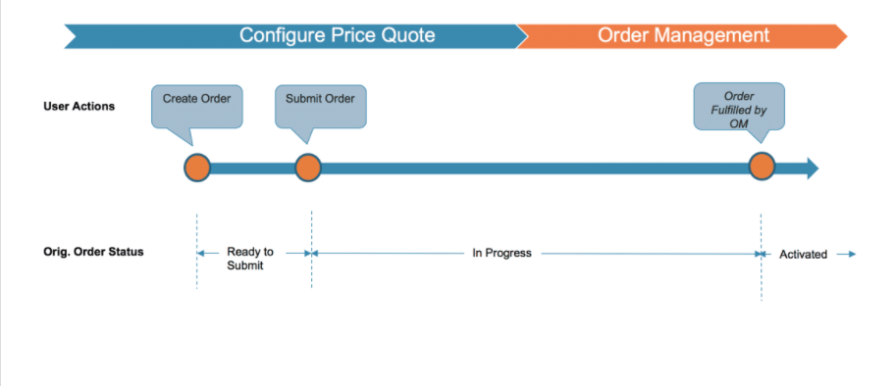
CPQ/OM Communications - High Level View(Standard Order)
This basic process flow diagram shows communication between CPQ and Order Management, including the status of the original order as standard user actions progress (create, submit, and order fulfillment by Order Management).
Note: Although this presentation refers to "User Actions" such as the Cancel Order button in the Cart, the process could be initiated via the CPQ API.

Slide 57
CPQ/OM Communications - High Level View(Order Cancellation)
The order cancelation process is a bit more involved.
User Actions / System Events – Create, submit and cancel order are initiated by the user, other actions are actually system events automatically triggered based on configuration and prior user events.
Create/submit supplemental order (this happens in the background without user intervention)
Order cancellation and fulfillment by Order Management
Original Order Status – Additional order states are required to implement order cancellations. Both CPQ and OM communicate and query the new states.
The original order transitions from Cancel Requested to Superseded (assuming the order is not past PONR, and the cancel is performed).
Supplemental Order Status – The CPQ generated supplemental order needed to implement the cancellation requires new order states as well.
If all goes well between CPQ and OM during the cancellation process, the state transitions from Cancel in Progress to Canceled.
Not only does CPQ automatically generate the supplemental order, it decomposes it as well, and links it to the original order.
Note that similar to a locked or read-only order, the canceled supplemental order can’t be changed.

Slide 58
Additional New Concepts Run-time status of Orchestration Items
Frozen – Cancel Order has been requested but not confirmed yet
Canceled – Pending or completed task are successfully cancelled
Discarded – Has not been executed when a supplemental order required that it can be canceled. (Discarded tasks are not executed)
Amended – Task are amended by a supplemental order. (Amended tasks are not executed)
PONR Details
There are a few more PONR related details to understand. The details are widely known throughout the industry as the GAAG of PONR.
Golden Rule
Appearance
Assetization
Granularity
Actually, GAAG isn't widely known throughout the industry. In fact it is not known at all, but it seemed like a good time to introduce a new acronym. ;-)

Slide 59
PONR Details
Golden Rule
A task in an executing orchestration plan reaches PONR when it advances to any of the following states: Completed, Running¹, Failed, Fatally Failed.
¹ How a running task impacts freezing of an order during a cancel request depends on its "Cancel/Amend Behavior" setting. This setting is also known as Smart Freeze
Appearance
The circle/slash icon indicates the Orchestration Item Definition (e.g. task) has been set as PONR.
Assetization
If no PONR is defined, once the order is assetized, it cannot be canceled. There is no out of the box way to un-assetize. In most cases you should activate PONR on your Assetization auto-task*.
Granularity
Order Management supports cancellation at the order-item level. (The initial implementation allowed for the entire order to be canceled, not individual items within the order.)
When an order item that is marked as PONR moves to a Running state, then the following state changes occur:
The order items that are linked to the PONR orchestration item are marked as PONR
All upstream order items are marked as PONR, all the way to the root order item
All children of the root order item, and their children, are marked as PONR

Slide 60
Rollback Plans
Rollback Plans are for undoing whatever was already completed in an orchestration plan when an in-flight order was canceled. For example, if ports and copper pair were allocated for an order, and the order is canceled... a Rollback Plan can be used to free up those resources. Rollback Plans are built in the same manner as regular orchestration plans, but they do have a few differences you need to be aware of. Setting up Rollback Plans presupposes you already have the orchestration assets in place. That is, Orchestration Plan Definitions, associated Orchestration Scenarios and Orchestration Item Definitions.
Create Orchestration Plan Definition
First, you create an Orchestration Plan Definition. It's the same exact thing as a regular orchestration plan. (In fact, it is the same UI, same everything.) Since it is the same as a regular plan, you may want to establish a naming convention,
such as: Rollback <NameOfPlan>
For example: Rollback Equipment Dispatch
Create Orchestration Item Definitions
Create Orchestration Item Definitions (e.g. tasks) within the new rollback plan. For example:
Schedule Technician callout
Recover Equipment callout
The rollback plan can have one or more tasks. All of the same record types are supported
(Milestone, Callout, ... Push Events.) If there are multiple tasks, dependencies between tasks works the same too.

Slide 61
Rollback Plans
Associate the Orchestration Plan with the Rollback Plan
A task within the standard orchestration plan needs to be associated with your new rollback plan. This is done by setting the Rollback Plan Definition field in a task to the actual Rollback Plan name.
This is an important distinction to make:
Orchestration Scenarios within standard Orchestration Plan Definitions are used to trigger additional swimlanes at run-time.
The Rollback Plan Definition setting within a Orchestration Item Definition (e.g. task) in a standard Orchestration Plan Definition is what triggers a Rollback Plan. (That is, Orchestration Scenarios are NOT used.) A dependency is automatically established. You do not have to create one from the Related tab.
Summary
Execution of tasks within rollback plans are used to effectively "undo" completed tasks in a standard plan when an order is canceled. Although most everything functions exactly the same with respect to standard orchestration and rollback plans, it's vital to understand that the Rollback Plan Definition field is used to trigger rollbacks.
Note: ROLLbacks are great... but don't look, smell or taste as good as these. Oh well. Off to the the coffee shop...

Slide 62
Rollback Groups
Rollback Groups are the last key concept to understand when it comes to implementing in-flight order cancellations.
Rollback Groups change the order of execution of rollback swimlanes
By default, Rollback Groups execute in the same order as the original orchestration swimlanes
Rollback Groups do not change the execution order of tasks within them. (That remains a function of dependencies.)

